Slide 1
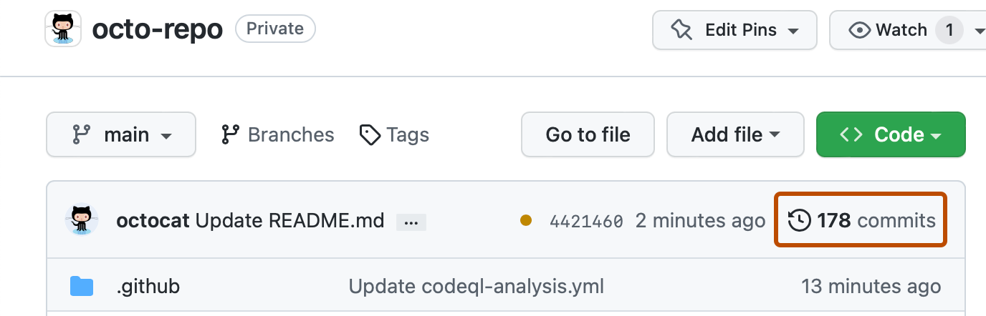
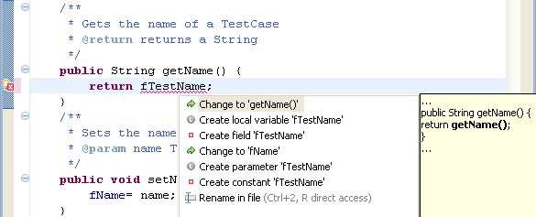
Java,
Eclipse
& GitHub
github.com
Seminar 1 · OBJECT-ORIENTED PROGRAMMING
java -version
→ 25
Eclipse
Today you set up the three tools you will use every week, and push your first commit.
Alba Meca

Slide 2
Four stops, one goal: your first push
TODAY
01
02
03
04
The course & OOP
Java
Eclipse
Git & GitHub
What we'll build and how we'll think
Install it, compile & run
Install it, run a class
Your repo, your first push
Object Oriented Programming · Seminar 1 · 2

Slide 3
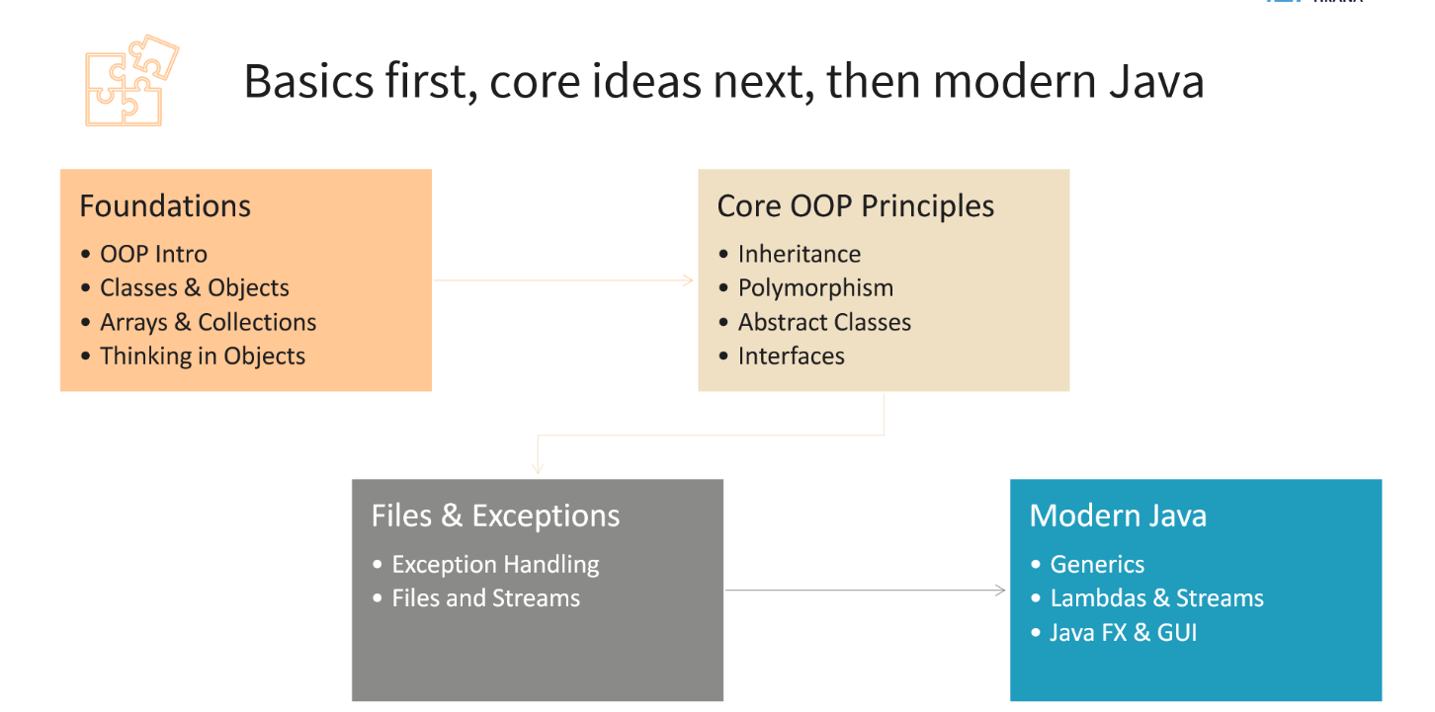
THE COURSE
Object Oriented Programming · Seminar 1 · 3

Slide 4
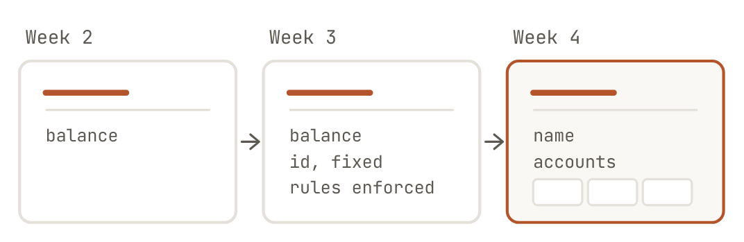
Following an example teaches syntax. Building teaches the skill.
THE COURSE
LECTURE · 2 HOURS
SEMINAR · 2 HOURS · TODAY
Theory and live coding. One example grows all semester: a small bank.
You write the code, on a different problem: the university system. One folder, one repository, extended every week.
Nothing restarts from zero. By week 4 your seminar folder becomes the starting point for Sprint 1.
Object Oriented Programming · Seminar 1 · 4

Slide 5
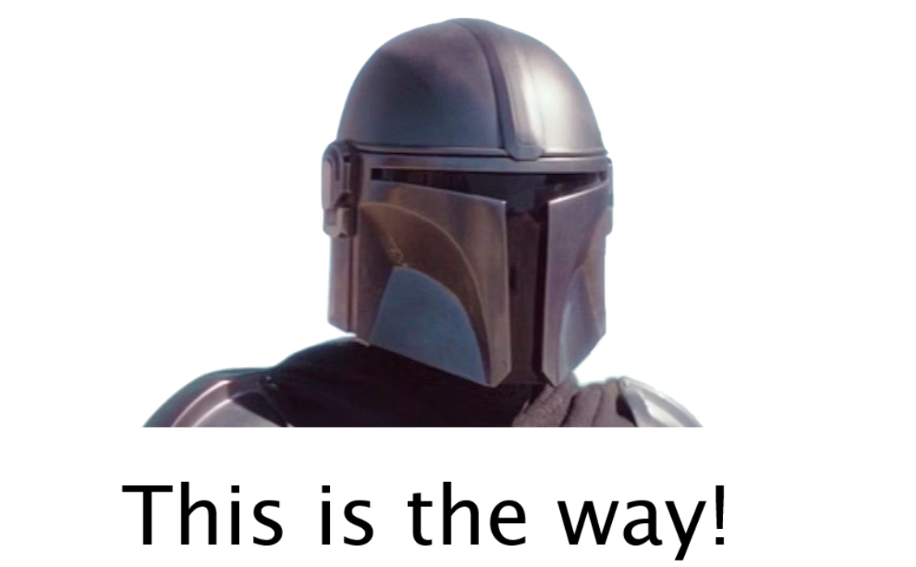
The only way to learn a programming language is by coding.
Object Oriented Programming · Seminar 1 · 5

Slide 6
Hands up if you have ever…
used an OOP language
used Java
pushed code to GitHub
lost work you really needed
Object Oriented Programming · Seminar 1 · 6

Slide 7
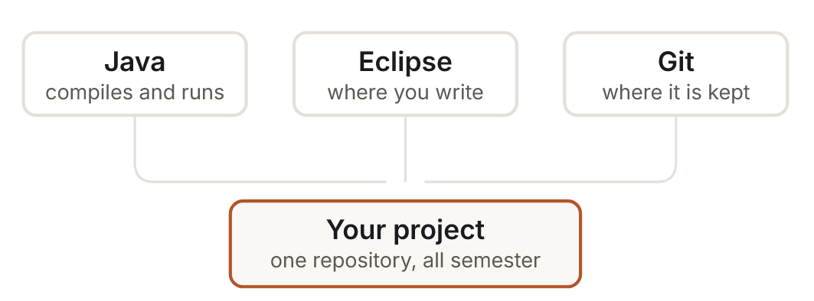


Three tools, in this order
TODAY
You are done when:
java -version reports 25
javac -version reports 25
Eclipse opens and runs a class
Your repo exists on GitHub with a commit you pushed
Not in OneDrive, Desktop or Documents. Cloud sync rewrites files while the compiler reads them. Use C:\dev\
Install Java before Eclipse. Most setup problems come from doing it the other way round.
Object Oriented Programming · Seminar 1 · 7

Slide 8
Object-oriented
languages
01
PART 1 OF 4
Programs built from objects that hold data and behaviour together

Slide 9
“I thought of objects being like biological cells and/or individual computers on a network, only able to communicate with messages […].”
Dr. Alan Kay
Dr. Alan Kay on the Meaning of “Object-Oriented Programming”, 2003. Retrieved 11 February 2010
Object Oriented Programming · Seminar 1 · 9
Notes:
Alan Kay coined “object-oriented”. Objects keep their own data inside, like a cell, and cooperate by sending messages: in Java, calling methods. This is the mental model for the whole course.

Slide 10

One blueprint, many objects
01 · OBJECT-ORIENTED LANGUAGES
CLASS = the blueprint
OBJECTS = the real things
Student.java
ana : Student
name = "Ana" gpa = 3.6
public class Student {
String name;
double gpa;
void updateGpa(...) { ... }
}
Student ana = new Student(...);
erion : Student
name = "Erion" gpa = 3.1
sara : Student
name = "Sara" gpa = 3.9
Object Oriented Programming · Seminar 1 · 10
Notes:
The class is the cookie cutter, objects are the cookies.

Slide 11
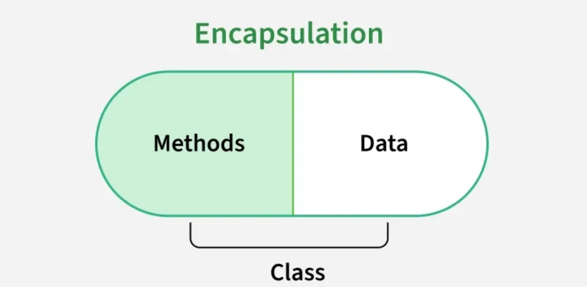
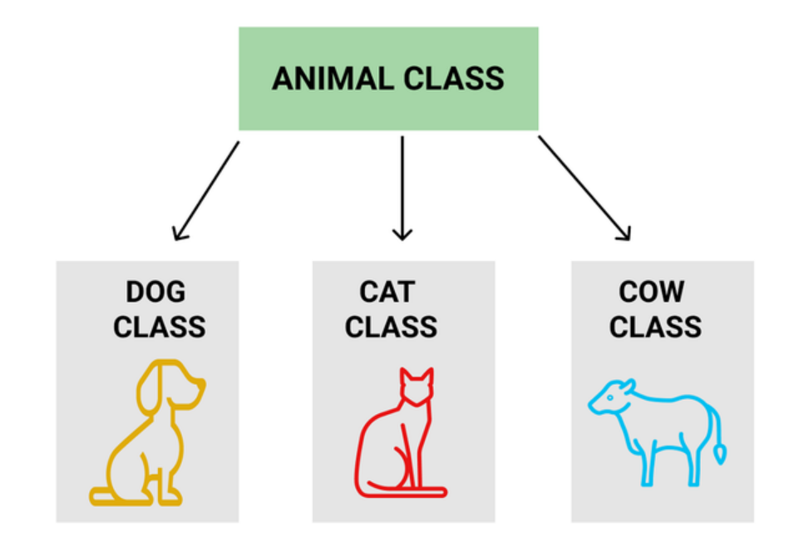
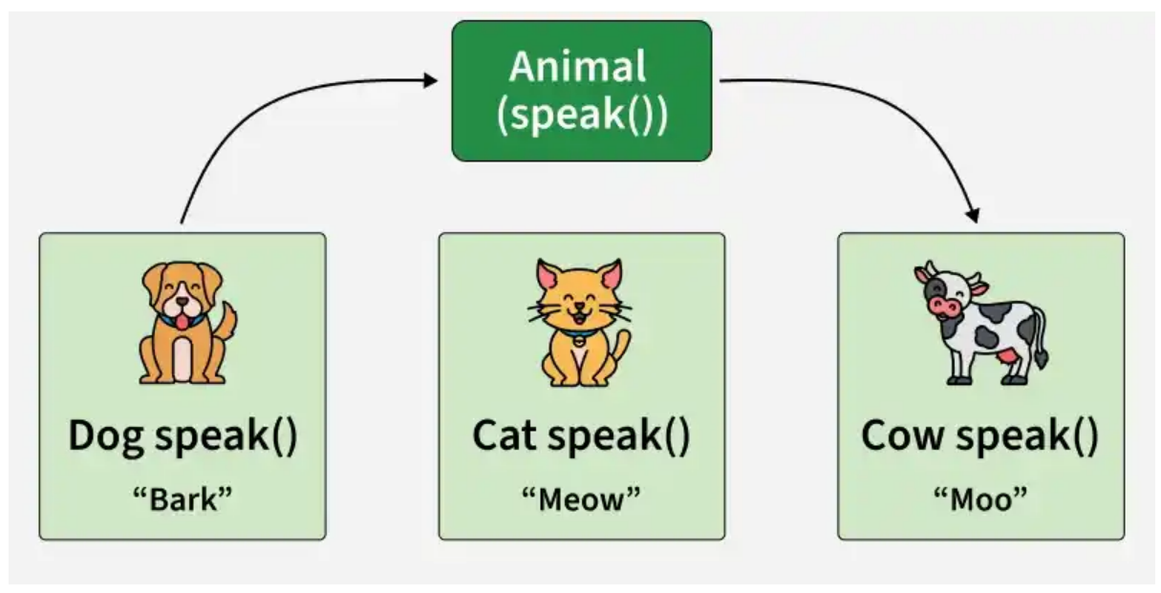
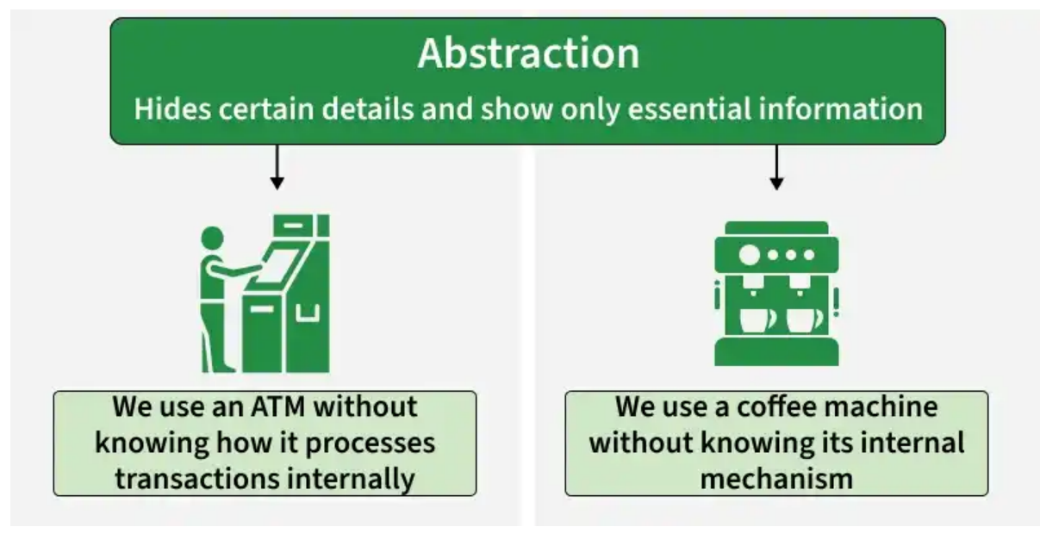
The four pillars of OOP
01 · OBJECT-ORIENTED LANGUAGES
Encapsulation
Inheritance
Polymorphism
Abstraction
Keep data and the methods that guard it together, and hide the data.
A class reuses and extends another: a Dog is an Animal.
One call, different behaviour: each animal speaks its own way.
Use something by what it does, not how: an ATM, a coffee machine.
class Dog extends Animal
private double balance;
public void deposit(...)
animal.speak();
// Bark? Meow? Moo?
atm.withdraw(50);
// how? hidden from you
Object Oriented Programming · Seminar 1 · 11
Notes:
Encapsulation: the capsule keeps data and methods together; the bank balance only changes through deposit.
Inheritance: Dog, Cat and Cow all get what Animal has.
Polymorphism: the same call speak() gives Bark, Meow or Moo depending on the object.
Abstraction: you use the ATM through withdraw, you never see how the bank processes it.
Each pillar gets its own lecture later.

Slide 12
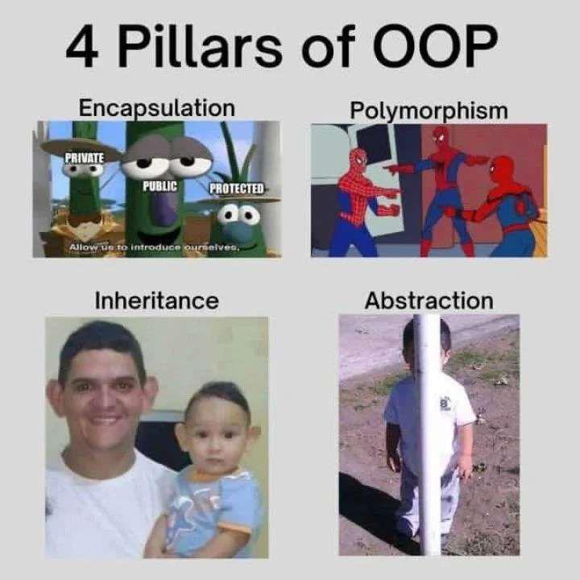
Object Oriented Programming · Seminar 1 · 12

Slide 13
OOP is an idea. Many languages use it.
01 · OBJECT-ORIENTED LANGUAGES
1995
Java
Class-based, statically typed. Enterprise, Android, back-ends.
1985
1991
2000
2011
1972
C++
Python
C#
Kotlin
2014
Smalltalk
OO added to C
Data, scripts, AI
.NET, Unity games
Android, runs on the JVM
Swift
THIS COURSE
Pure OO
iOS apps
Learn OOP once. Switching languages later is mostly new syntax.
Object Oriented Programming · Seminar 1 · 13
Notes:
OOP is an idea, not a language. Kotlin runs on the same JVM as Java, so Java skills transfer.

Slide 14
Java
02
PART 2 OF 4
Install it, then compile and run a program without any editor.

Slide 15
In Java, all code belongs to a class.
Methods, fields, even lambdas and streams sit inside classes.
Object Oriented Programming · Seminar 1 · 15
Notes:
Every method and field is declared inside a class or interface

Slide 16
Java Characteristics
02 · JAVA
Simple
Object-Oriented
Distributed
Interpreted
Robust
Secure
Architecture-Neutral
Portable
Performant
Multithreaded
Dynamic
From the original Java white paper
Object Oriented Programming · Seminar 1 · 16

Slide 17
Characteristics of Java
02 · JAVA
Java is Simple
Java is Simple
Java is Object-Oriented
Java is Distributed
Java is partially modeled on C++, but greatly simplified and improved. Some people call it “C++--”: like C++, with more functionality and fewer negative aspects.
Java is Interpreted
Java is Robust
Java is Secure
Java is Architecture-Neutral
▸ Shares many syntax elements with C/C++
Java is Portable
▸ Learning curve less steep for C/C++ programmers
Java's Performance
Java is Multithreaded
Java is Dynamic
Object Oriented Programming · Seminar 1 · 17

Slide 18
Characteristics of Java
02 · JAVA
Java is Simple
Java is Object-Oriented
Java is Object-Oriented
Java is Distributed
Java was designed from the start to be object-oriented. OOP gives flexibility, modularity, clarity and reusability through encapsulation, inheritance and polymorphism.
Java is Interpreted
Java is Robust
Java is Secure
Java is Architecture-Neutral
▸ Quasi-pure OO: only classes and objects, no free functions or pointers
Java is Portable
Java's Performance
▸ Basic types (int, double…) are the exception
Java is Multithreaded
Java is Dynamic
Object Oriented Programming · Seminar 1 · 18

Slide 19
Characteristics of Java
02 · JAVA
Java is Simple
Java is Distributed
Java is Object-Oriented
Java is Distributed
Distributed computing means several computers working together on a network. Networking is built into Java, so writing network programs is like sending and receiving data to and from a file.
Java is Interpreted
Java is Robust
Java is Secure
▸ Network programming in the standard library: sockets, RMI
Java is Architecture-Neutral
Java is Portable
Java's Performance
Java is Multithreaded
Java is Dynamic
Object Oriented Programming · Seminar 1 · 19

Slide 20
Characteristics of Java
02 · JAVA
Java is Simple
Java is Interpreted
Java is Object-Oriented
Java is Distributed
Programs are compiled into Java Virtual Machine code called bytecode. Bytecode is machine-independent and runs on any machine that has a JVM.
Java is Interpreted
Java is Robust
Java is Secure
Java is Architecture-Neutral
▸ Translated to an intermediate language: bytecode
Java is Portable
▸ Interpreted with optimizations (JIT)
Java's Performance
Java is Multithreaded
Java is Dynamic
Object Oriented Programming · Seminar 1 · 20

Slide 21
Characteristics of Java
02 · JAVA
Java is Simple
Java is Robust
Java is Object-Oriented
Java is Distributed
Java compilers detect many problems that would only show up at run time in other languages. Error-prone constructs from other languages are gone, and runtime exception handling supports robustness.
Java is Interpreted
Java is Robust
Java is Secure
Java is Architecture-Neutral
Java is Portable
▸ Strong type model, no explicit pointers: compile-time checks
Java's Performance
▸ Run-time checks: no array overflow
Java is Multithreaded
▸ Garbage collection: no manual memory freeing
Java is Dynamic
▸ Exceptions: a pervasive mechanism to check errors
Object Oriented Programming · Seminar 1 · 21

Slide 22
Characteristics of Java
02 · JAVA
Java is Simple
Java is Secure
Java is Object-Oriented
Java is Distributed
Java implements several security mechanisms to protect your system against harm caused by stray programs.
Java is Interpreted
Java is Robust
▸ Bytecode is verified before it runs
Java is Secure
Java is Architecture-Neutral
Java is Portable
Java's Performance
Java is Multithreaded
Java is Dynamic
Object Oriented Programming · Seminar 1 · 22

Slide 23
Characteristics of Java
02 · JAVA
Java is Simple
Java is Portable
Java is Object-Oriented
Java is Distributed
Because Java is architecture-neutral, Java programs are portable: they run on any platform without being recompiled.
Java is Interpreted
Java is Robust
▸ Lots of standard utilities included: threads, GUI, networking
Java is Secure
Java is Architecture-Neutral
Java is Portable
Java's Performance
Java is Multithreaded
Java is Dynamic
Object Oriented Programming · Seminar 1 · 23

Slide 24
Characteristics of Java
02 · JAVA
Java is Simple
Java's performance
Java is Object-Oriented
Java is Distributed
The JVM’s just-in-time (JIT) compiler turns frequently executed bytecode into native machine code while the program runs, so Java programs run fast.
Java is Interpreted
Java is Robust
Java is Secure
▸ Bytecode + JIT: close to native speed
Java is Architecture-Neutral
Java is Portable
Java's Performance
Java is Multithreaded
Java is Dynamic
Object Oriented Programming · Seminar 1 · 24

Slide 25
Characteristics of Java
02 · JAVA
Java is Simple
Java is Multithreaded
Java is Object-Oriented
Java is Distributed
Multithreaded programming is smoothly integrated in Java. In other languages you call procedures specific to the operating system to get threads.
Java is Interpreted
Java is Robust
Java is Secure
▸ Concurrency (threads) is part of the standard library
Java is Architecture-Neutral
Java is Portable
Java's Performance
Java is Multithreaded
Java is Dynamic
Object Oriented Programming · Seminar 1 · 25

Slide 26
Characteristics of Java
02 · JAVA
Java is Simple
Java is Dynamic
Java is Object-Oriented
Java is Distributed
Java adapts to an evolving environment: new code can be loaded on the fly, without recompiling, and new features incorporated transparently as needed.
Java is Interpreted
Java is Robust
Java is Secure
Java is Architecture-Neutral
▸ Run-time loading and linking
Java is Portable
▸ Dynamic array sizes
Java's Performance
Java is Multithreaded
Java is Dynamic
Object Oriented Programming · Seminar 1 · 26

Slide 27
Java, web and beyond
02 · JAVA
Standalone applications
Web servers
Desktop programs and tools, like Eclipse itself.
The back-end of banking, shopping and booking sites.
Hand-held devices
From a browser
Android apps run Java and Kotlin.
Once via applets; today the browser talks to a Java server.
Object Oriented Programming · Seminar 1 · 27

Slide 28
One first-level concept: the class
02 · JAVA
■
There is only one first-level concept: the class
First.java
public class First {
}
■
The source code of a class sits in a .java file with the same name
◆
Rule: one file per class
◆
Enforced automatically by IDEs
◆
Case-wise name correspondence: first.java ≠ First.java
Object Oriented Programming · Seminar 1 · 28

Slide 29
No functions, only methods
02 · JAVA
■
In Java there are no functions, only methods within classes
■
Execution starts from one special method:
public static void main(String[] args)
◆
Return type is void. In C: int main(int argc, char* argv[])
◆
args[0] is the first argument on the command line, after the program name
Object Oriented Programming · Seminar 1 · 29
Notes:
java First hello gives args[0] = "hello".

Slide 30
Example: source code
02 · JAVA
First.java
What does it print?
public class First {
public static void main(String[] args) {
int a;
a = 3;
System.out.println(a);
}
}
Then: javac First.java, then java First.
Object Oriented Programming · Seminar 1 · 30

Slide 31
Creating and editing using Notepad
02 · JAVA
PowerShell
To use Notepad, type notepad Welcome.java at the prompt.
PS> notepad Welcome.java
Welcome.java - Notepad
// This application program prints Welcome to Java!
public class Welcome {
public static void main(String[] args) {
System.out.println("Welcome to Java!");
}
}
Object Oriented Programming · Seminar 1 · 31

Slide 32
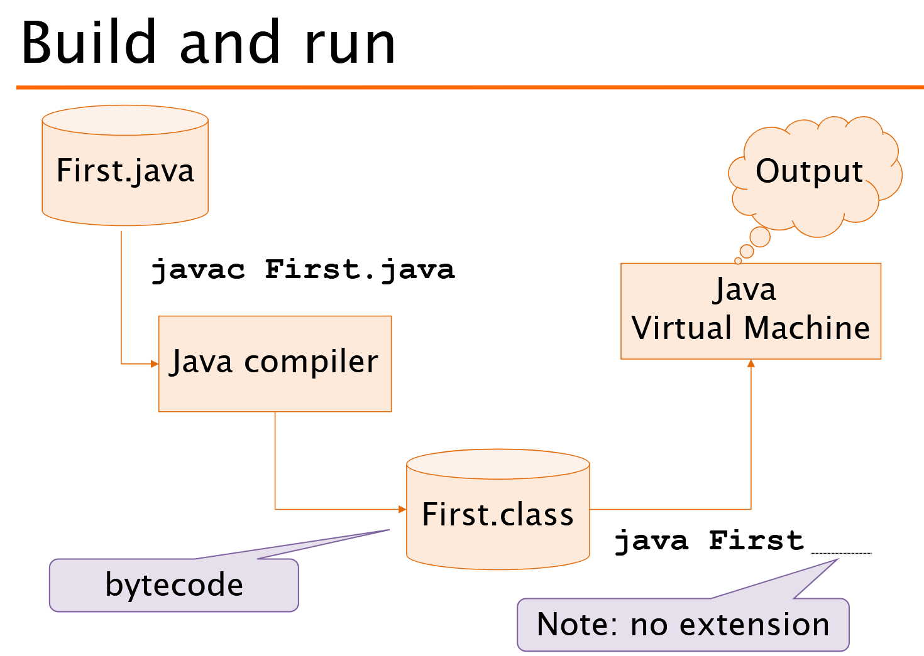
Build and run
02 · JAVA
javac First.java turns source into First.class: bytecode.
java First runs it on the JVM.
No extension!
Object Oriented Programming · Seminar 1 · 32

Slide 33
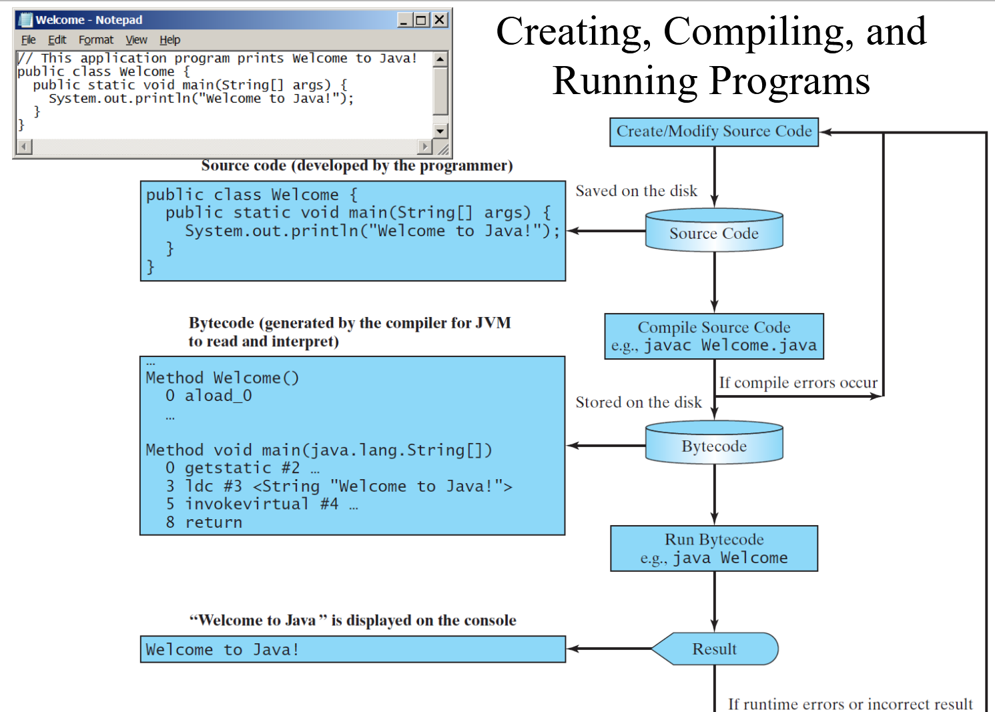
Object Oriented Programming · Seminar 1 · 33

Slide 34
What happens when you type java First
02 · JAVA
■
Command: java First
◆
Take the name of the class (First)
◆
Look for the bytecode for that class, in the classpath (and the current folder)
◆
Load the class’s bytecode and perform all due initializations
◆
Look for the main() method
◆
Start execution from the main() method
Object Oriented Programming · Seminar 1 · 34

Slide 35
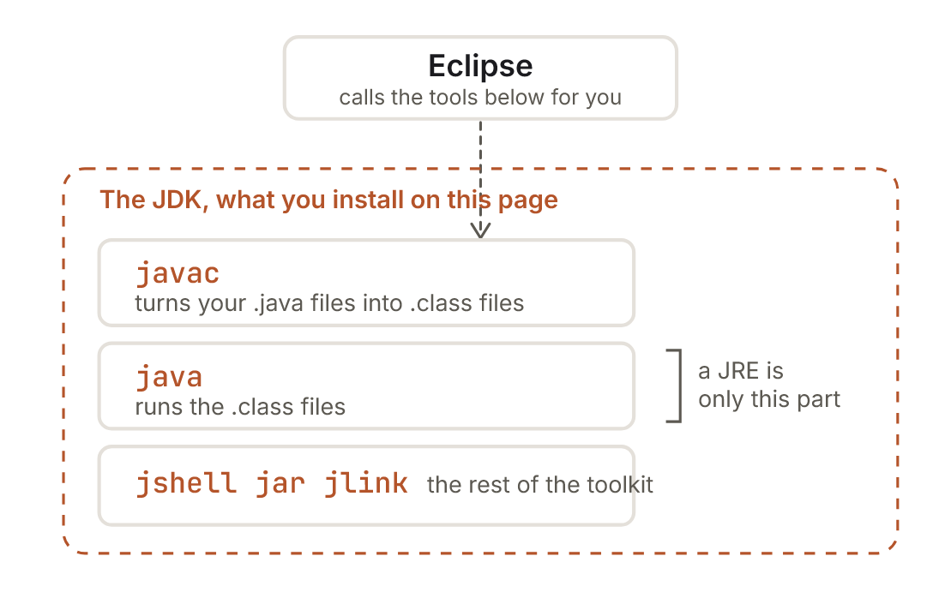
What you actually install: the JDK
02 · JAVA
A JRE can run Java. It cannot compile it.
Install a JRE by mistake and you can run other people's programs but not your own. We install the full JDK.
Object Oriented Programming · Seminar 1 · 35

Slide 36
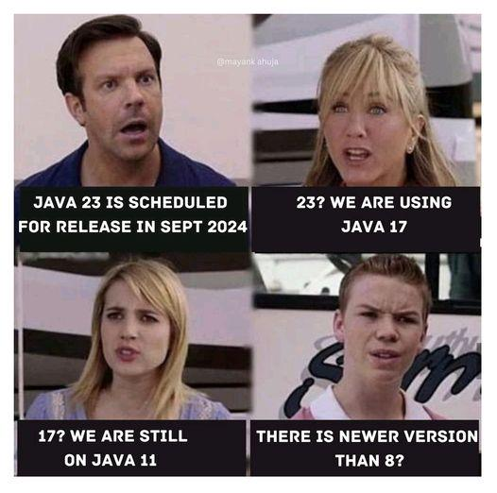
Which Java? This course: 25
02 · JAVA
A new Java every six months. Every two years one is LTS, long-term support. Companies stay on LTS versions for years.
History: JDK 1.0 (1996), 1.2 (1998), 5 (2004), 6 (2006), 7 (2011), 8 (2014). Since 2017, every six months.
8
11
17
21
25
2014
2018
2021
2023
2025
We use Eclipse Temurin 25, the free OpenJDK build. Not Oracle's download: different licence, same Java.
Object Oriented Programming · Seminar 1 · 36

Slide 37
Install Java 25 (Temurin JDK)
DO IT NOW · FOLLOW ALONG
1
Open PowerShell: Start menu, type PowerShell.
PowerShell
2
Run the install command on the right.
PS> winget install -e --id
EclipseAdoptium.Temurin.25.JDK
3
Close PowerShell and open a new one. PATH only updates in new windows.
Mac: download the .pkg from adoptium.net and double-click it. Apple chip (M1–M4): aarch64. Intel: x64.
4
No winget? Use the .msi from adoptium.net: Windows, x64, JDK, 25. Tick Set JAVA_HOME and Add to PATH.
adoptium.net ↗
Course page: Install Java ↗
Object Oriented Programming · Seminar 1 · 37

Slide 38
Prove it: no editor needed
DO IT NOW · FOLLOW ALONG
1 · Check the versions
2 · Compile by hand
PS> java -version
openjdk version "25.0.x" ...
PS> javac -version
javac 25.0.x
PS> jshell
jshell> System.out.println("Running on "
+ Runtime.version());
Running on 25.0.x
jshell> /exit
PS> mkdir C:\dev\jdkcheck
PS> cd C:\dev\jdkcheck
PS> notepad Check.java
...type the class, save...
PS> javac Check.java
PS> java Check
Compiled and running on 25.0.x
Check.java prints "Compiled and running on " + Runtime.version(). Both numbers must start with 25. Mac: use Terminal and ~/dev/jdkcheck.
Object Oriented Programming · Seminar 1 · 38
Notes:
If java and javac show different versions, there are two Javas on the machine: see troubleshooting.

Slide 39
Reading the program
02 · JAVA
Check.java
1
public class Check
File must be named Check.java
1 public class Check {
2 public static void main(String[] args) {
3 System.out.println("Hello, OOP!");
4 }
5 }
2
main(...)
Where every program starts
3
System.out.println
Prints one line to the console
4
;
Console
Ends every statement. Don't forget it.
Hello, OOP!
Object Oriented Programming · Seminar 1 · 39

Slide 40
EXPECTATION
REALITY
It just
works.
One tiny
semicolon.
PowerShell
PowerShell
PS> javac Check.java
PS> java Check
Hello, OOP!
Check.java:3: error: ';' expected
System.out.println("Hello, OOP!")
^
1 error
Object Oriented Programming · Seminar 1 · 40

Slide 41


Java cares about names. A lot.
02 · JAVA
PowerShell
PS> javac check.java
check.java:1: error: class Check is public, should be
declared in a file named Check.java
public class Check {
^
1 error
check.java
Check.java.txt
Check.java
Notepad loves adding .txt. In File Explorer turn on View › Show › File name extensions.
Object Oriented Programming · Seminar 1 · 41

Slide 42
“Java can’t find my class”
02 · JAVA
PowerShell
Error: Could not find or load main class First
Caused by: java.lang.ClassNotFoundException: First
■
Don’t include the extension: java First, not java First.class
■
Check you are in the right folder: java looks for classes starting from the current working directory
■
Check the capitals: first is not First
Object Oriented Programming · Seminar 1 · 42

Slide 43
Coding conventions
02 · JAVA
■
Use camelBackCapitalization for compound names, not underscores
■
Class names must be Capitalized
■
Method names, object names, attributes and variables start in lowercase
■
Constants are all UPPERCASE (with underscores)
■
Indent properly
Object Oriented Programming · Seminar 1 · 43

Slide 44
Coding conventions: example
02 · JAVA
ClassName.java
class ClassName {
static final double PI = 3.14;
private int attributeName;
public void methodName() {
int count = 0;
if (count == 0) { }
}
}
Object Oriented Programming · Seminar 1 · 44

Slide 45
Deployment: jar files
02 · JAVA
■
Java programs are packaged and deployed in jar files
■
A jar is a compressed archive
◆
Like a zip file
◆
Contains additional meta-information
■
A JVM can run the contents of a jar directly
◆
The JVM loads classes from inside the jar: java -jar app.jar
Object Oriented Programming · Seminar 1 · 45

Slide 46
Java in one slide
02 · JAVA
■
Java is a quasi-pure object-oriented language
■
Compiled to bytecode, then interpreted with JIT
■
Robust: no explicit pointers, static and dynamic checks, garbage collection
■
Many utilities: data types, threads, networking, graphics
■
Used for many kinds of programs
■
Coding conventions are not “just aesthetic”
Object Oriented Programming · Seminar 1 · 46
Notes:
Wrap-up of the Java part, before Eclipse.

Slide 47
Eclipse
03
PART 3 OF 4

Slide 48
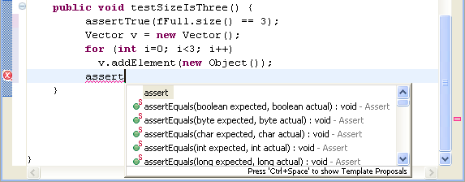
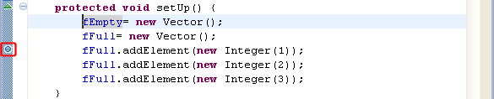
Shortcuts worth learning today
03 · ECLIPSE
Autocomplete
Quick fix
Debugger
Autocomplete
Quick fix
Debugger
Windows
Ctrl + Space
Windows
Ctrl + 1
Windows
F11
Mac
Ctrl + Space
Mac
⌘ Cmd + 1
Mac
⌘ Cmd + F11
Run
Format
Rename
Open class
Win Ctrl+F11
Win Ctrl+Shift+F
Win Alt+Shift+R
Win Ctrl+Shift+T
Mac ⌘+Shift+F11
Mac ⌘+Shift+F
Mac ⌥+⌘+R
Mac ⌘+Shift+T
Object Oriented Programming · Seminar 1 · 48

Slide 49
All good tools. We pick one.
03 · ECLIPSE
IDE | Cost | Strengths | Keep in mind
Eclipse | Free, open source | Mature Java tools, plugins | Interface feels busy at first
IntelliJ IDEA | Free tier + paid edition | Excellent code assistance | Heavier on memory
VS Code | Free | Lightweight, many languages | Java support via extensions
NetBeans | Free, open source | Simple setup, GUI builder | Smaller community
BlueJ | Free | Designed for teaching OOP | Not used in industry
Prefer another editor? Fine: projects are plain Java (later plain Maven). You still need Java 25 and git.
Object Oriented Programming · Seminar 1 · 49

Slide 50

Why we use Eclipse
03 · ECLIPSE
Built for Java
Same screens for everyone.
Errors and quick fixes as you type.
Strong debugger
Breakpoints, variables, step by step.
A problem takes two minutes to solve instead of twenty.
Free & open source
Same tool at home and in the lab.
Nothing depends on it
Plain Java projects you can build anywhere.
Object Oriented Programming · Seminar 1 · 50

Slide 51
Install Eclipse
DO IT NOW · FOLLOW ALONG
1
eclipse.org/downloads › Eclipse Installer, Windows x86_64.
PowerShell · step 2
2
Check the file before running it: compare its SHA-512 with the one on the download page.
PS> Get-FileHash
"$HOME\Downloads\eclipse-inst-jre-win64.exe"
-Algorithm SHA512
3
Run it › Eclipse IDE for Java Developers › Install › Launch. Blue SmartScreen box? More info › Run anyway (only after the hash matched).
Mac: Installer for AArch64 (Apple chip) or x86_64 (Intel). Hash: shasum -a 512 file.dmg. Workspace: ~/dev/workspace
4
Workspace: C:\dev\workspace. Tick Use this as the default.
eclipse.org/downloads ↗
Course page: Eclipse ↗
Object Oriented Programming · Seminar 1 · 51

Slide 52
Point Eclipse at your JDK 25
DO IT NOW · FOLLOW ALONG
1
Window › Preferences › Java › Installed JREs
Eclipse ships with its own small Java. Without this step it can seem to work, then fail later in a way that looks unrelated.
2
See jdk-25 listed and ticked? Done. Eclipse found it.
3
Otherwise: Add › Standard VM › Next. JRE home: C:\Program Files\Eclipse Adoptium\jdk-25…
Mac: Eclipse › Settings… › Java › Installed JREs. JDK folder: /Library/Java/JavaVirtualMachines/temurin-25.jdk/Contents/Home
4
Finish, tick the new entry, Apply and Close.
Object Oriented Programming · Seminar 1 · 52

Slide 53
Build something, then run it without Eclipse
DO IT NOW · FOLLOW ALONG
1
File › New › Java Project, name it Setup, Finish. (If “Create module-info.java” is ticked, untick it.)
inside main
2
Right-click src › New › Class, name it Check, tick public static void main, Finish.
System.out.println(
"Eclipse is running on "
+ Runtime.version());
3
Paste the line on the right inside main.
4
Run: Ctrl+F11 or the green ▶. Console says Eclipse is running on 25…
Then, outside Eclipse
PS> cd C:\dev\workspace\Setup\bin
PS> java Check
Eclipse is running on 25.0.x
Object Oriented Programming · Seminar 1 · 53

Slide 54
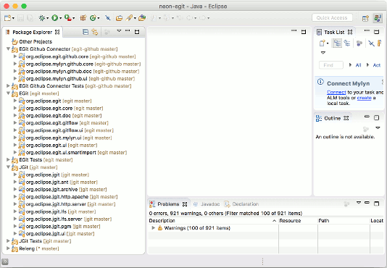
Finding your way around Eclipse
03 · ECLIPSE
Eclipse workbench
1
Package Explorer
Projects and files (left)
2
Editor
Where you write code (centre)
3
Outline
Fields and methods of the class (right)
4
Problems · Console
Errors and program output (bottom)
Turn on line numbers: Preferences › General › Editors › Text Editors › Show line numbers.
Panel gone? Window › Perspective › Reset Perspective.

Slide 55
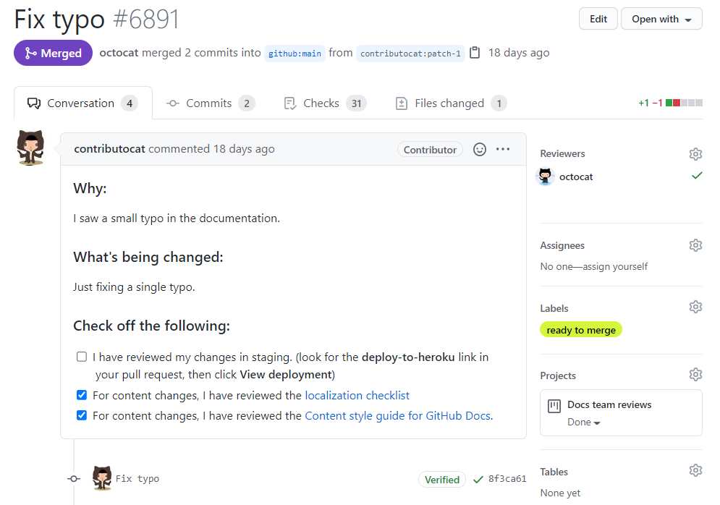
Git &
GitHub
04
github.com
PART 4 OF 4
Your work lives in a repository from week one, not in a folder on your laptop.

Slide 56
Be honest. Does your folder look like this?
04 · GIT & GITHUB
Downloads › OOP homework
Project.java
12 Sep
Who changed what?
Project_v2.java
14 Sep
When?
Project_final.java
20 Sep
Why?
Project_final_REALLY.java
21 Sep
SOUND FAMILIAR?
Which one works?
Project_final_fixed_Ana.java
21 Sep
Project_USE_THIS_ONE.java
22 Sep
Object Oriented Programming · Seminar 1 · 56

Slide 57
Git and GitHub are not the same thing
04 · GIT & GITHUB
Git
GitHub
A tool on your computer. Works offline, no account. Created by Linus Torvalds in 2005.
A website that hosts Git repositories, plus pull requests, issues, reviews.
Terminal · your laptop
github.com
$ git log --oneline
97b6b9b Add .gitignore for bin/ and .metadata/
e261f1f Fix rounding in getAverage()
da184f5 Add getAverage() to Student
e81e11f Add Student class with name and grade
51ed780 Add HelloWorld program
Git is the tool. GitHub is where you share what Git tracks.
Object Oriented Programming · Seminar 1 · 57

Slide 58






Six words, explained like a video game
04 · GIT & GITHUB
Your save file
A save point
An alternate route
Repository
Commit
Branch
A project folder whose whole history Git tracks.
A snapshot with a message, author and time.
A parallel line of work. Default: main.
Routes rejoin
Cloud save
Copy the save
Merge
Remote
Clone
Combine one branch's changes into another.
The copy on GitHub, usually called origin.
Download a repo with its full history.
Object Oriented Programming · Seminar 1 · 58
Notes:
Commit = save point, branch = alternate route, merge = routes rejoin, remote = cloud save.

Slide 59
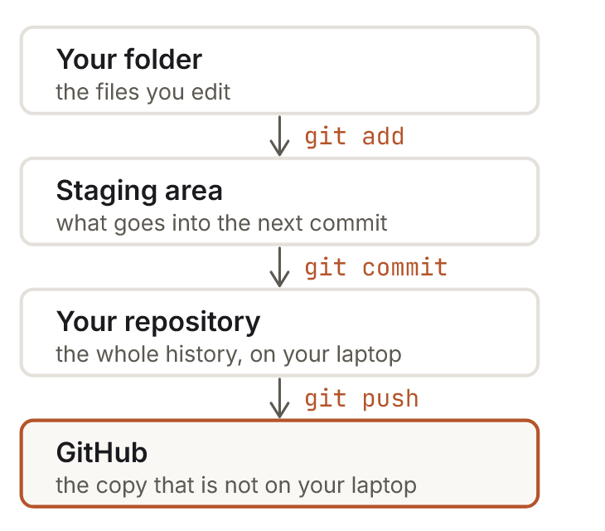
The four places your work lives
04 · GIT & GITHUB
Three of the four are on your laptop.
Only git push needs the internet. That's why most of git keeps working on a train.
git add chooses what goes in the next snapshot. git commit takes it. git push copies it to GitHub.
Object Oriented Programming · Seminar 1 · 59

Slide 60
Install Git and introduce yourself
DO IT NOW · FOLLOW ALONG
1
Install Git with the command on the right. Accept every default: they include Git Credential Manager.
PowerShell
2
Close PowerShell, open a new one, run git --version.
PS> winget install -e --id Git.Git
PS> git --version
PS> git config --global user.name "Ana Hoxha"
PS> git config --global user.email "ana@example.com"
3
Tell git who you are, once per computer. Use the email you'll use on GitHub.
4
Create a free account on github.com with that email.
Mac: run git --version in Terminal. If asked, click Install (Command Line Tools). That gives you git.
git-scm.com ↗
Course page: Git ↗
Object Oriented Programming · Seminar 1 · 60
Notes:
No winget? Download Git for Windows from git-scm.com and accept every default. The name and email end up in every commit.

Slide 61
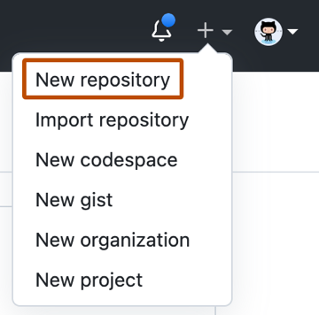
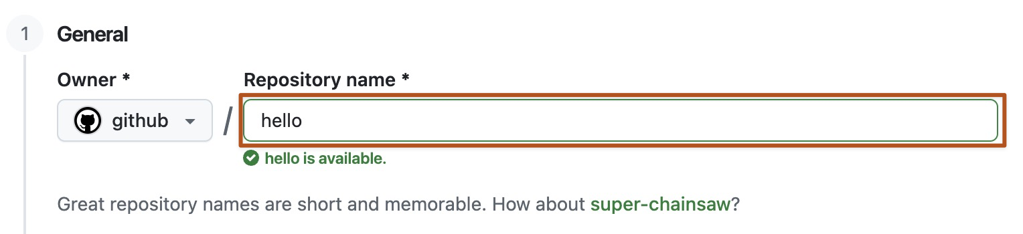
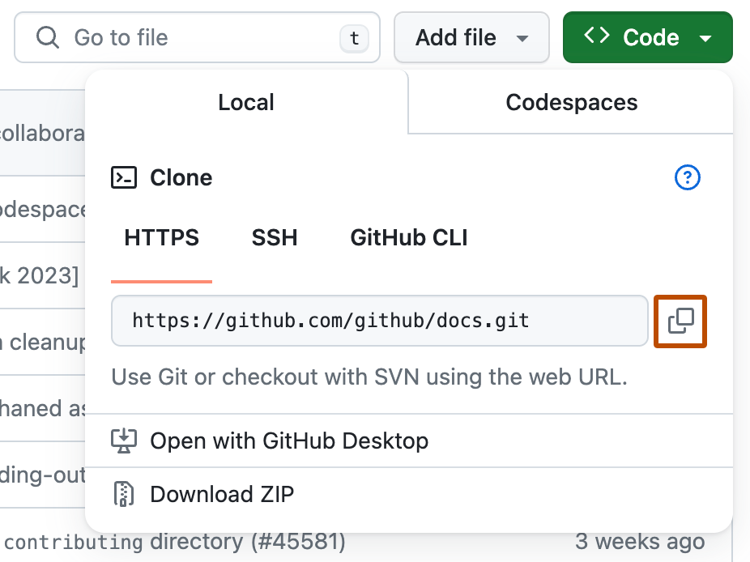
Create your repository on GitHub
04 · GIT & GITHUB
1
+ › New repository
2
Name: java-oop-surname
3
Copy the HTTPS URL
On the next page, under Quick setup, make sure HTTPS is selected and copy the URL. Ignore the commands below it.
Do not tick Add a README.
Object Oriented Programming · Seminar 1 · 61

Slide 62
Turn your project into a repository
DO IT NOW · FOLLOW ALONG
PowerShell
.gitignore
Never commit bin/. It is rebuilt from your code in a second and changes on every build.
PS> cd C:\dev\workspace\Setup
PS> git init
PS> notepad .gitignore
bin/
*.class
.settings/
.classpath
.project
Commit what you wrote, never what a tool produced from it.
Mac: cd ~/dev/workspace/Setup, then create the file with: open -e .gitignore (after touch .gitignore)
Object Oriented Programming · Seminar 1 · 62
Notes:
notepad .gitignore creates the file with exactly that name (no .txt) when you say Yes to create it. Check: dir -Force should list .gitignore.

Slide 63
Your first commit
DO IT NOW · FOLLOW ALONG
PowerShell
Read git status before you commit.
See bin/ in the list? Your .gitignore is in the wrong folder or has a typo.
PS> git add .
PS> git status
Changes to be committed:
new file: .gitignore
new file: src/Check.java
PS> git commit -m "First Java project, verifying the setup"
Object Oriented Programming · Seminar 1 · 63

Slide 64
Connect to GitHub and push
DO IT NOW · FOLLOW ALONG
PowerShell
A browser window opens asking you to sign in to GitHub. That's Git Credential Manager. Approve once; it won't ask again on this machine.
PS> git branch -M main
PS> git remote add origin
https://github.com/yourname/java-oop-surname.git
PS> git push -u origin main
Refresh your repository page: your files are there.
Mac: Terminal asks for a username and password instead. The password is a personal access token (GitHub › Settings › Developer settings), not your GitHub password.
Object Oriented Programming · Seminar 1 · 64
Notes:
Your GitHub account password never works for git push. Windows: Git Credential Manager handles it in the browser. Mac without GCM: a personal access token pasted as the password.

Slide 65
git status
04 · GIT & GITHUB
Before git add
After git add
PS> git status
On branch main
No commits yet
Untracked files:
(use "git add <file>..." to include)
Check.java
PS> git add Check.java
PS> git status
On branch main
Changes to be committed:
new file: Check.java
Red = Git sees it but won't save it. Green = in the next commit.
Object Oriented Programming · Seminar 1 · 65

Slide 66
The cheat sheet: eight commands
04 · GIT & GITHUB
Command | What it does
git config --global user.name "Ana" | Set your name once per computer (also user.email)
git init | Turn a folder into a repository
git status | See what changed and what is staged
git add <file> / git add . | Stage changes for the next commit
git commit -m "message" | Save a snapshot locally
git push | Upload your commits to GitHub
git pull | Download and merge new commits
git log --oneline | Show the history
Object Oriented Programming · Seminar 1 · 66

Slide 67
git log never forgets
04 · GIT & GITHUB
DON'T
DO
Terminal
Terminal
$ git log --oneline
f85b523 please work
bb5ccde final version 2
af40477 final version
b58b6d5 asdf
3a13266 fixed
1a4fc2a stuff
$ git log --oneline
97b6b9b Add .gitignore for bin/ and .metadata/
e261f1f Fix rounding in getAverage()
da184f5 Add getAverage() to Student
e81e11f Add Student class with name and grade
51ed780 Add HelloWorld program
A good message finishes the sentence: “If applied, this commit will…”
Object Oriented Programming · Seminar 1 · 67

Slide 68

Rejected? Don't panic.
04 · GIT & GITHUB
PowerShell
PS> git push -u origin main
! [rejected] main -> main (fetch first)
error: failed to push some refs
hint: Updates were rejected because the remote contains work that you do
hint: not have locally. ... use 'git pull' before pushing again.
The fix:
git pull --rebase origin main
git push
Object Oriented Programming · Seminar 1 · 68

Slide 69
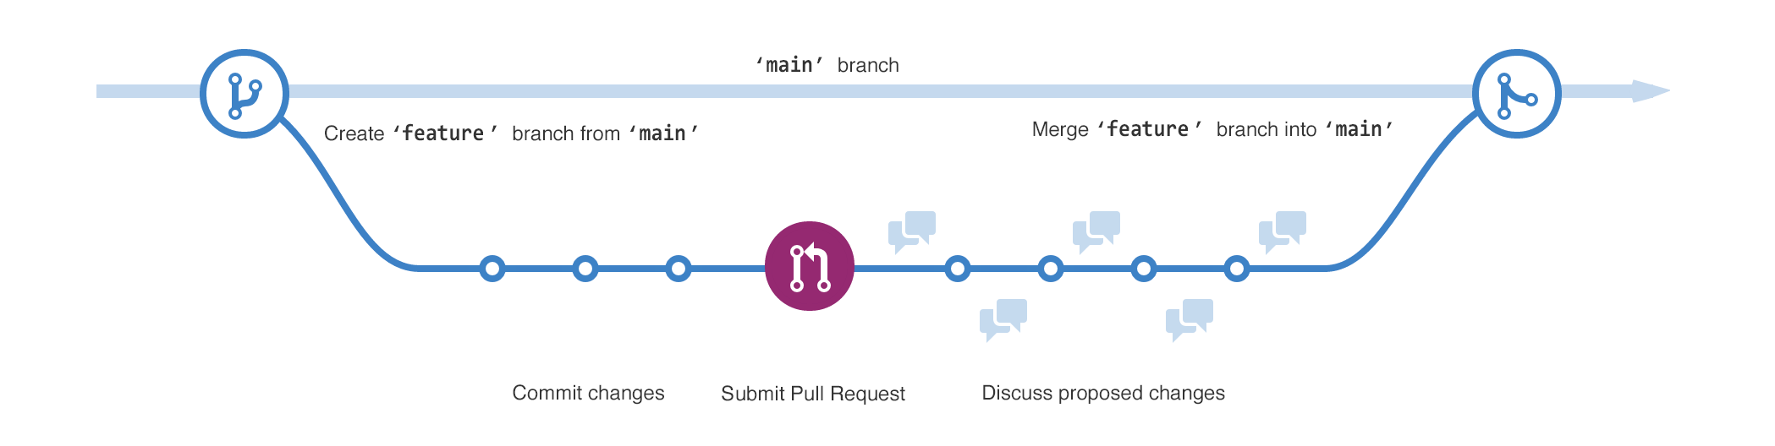
Later, in teams: branch, then pull request
04 · GIT & GITHUB
1
Branch
2
Commit
3
Push
4
Open PR
5
Review
6
Merge
Object Oriented Programming · Seminar 1 · 69

Slide 70
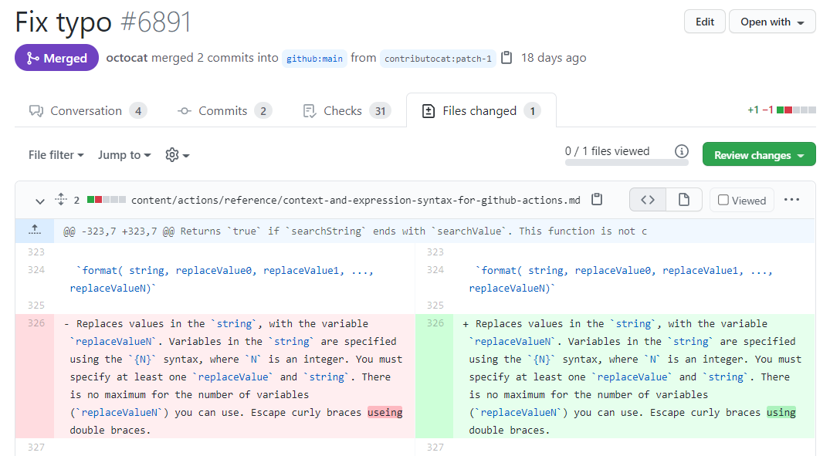
What a pull request looks like
04 · GIT & GITHUB
CONVERSATION: describe and discuss
FILES CHANGED: review line by line
github.com · pull request
github.com · files changed
Object Oriented Programming · Seminar 1 · 70

Slide 71
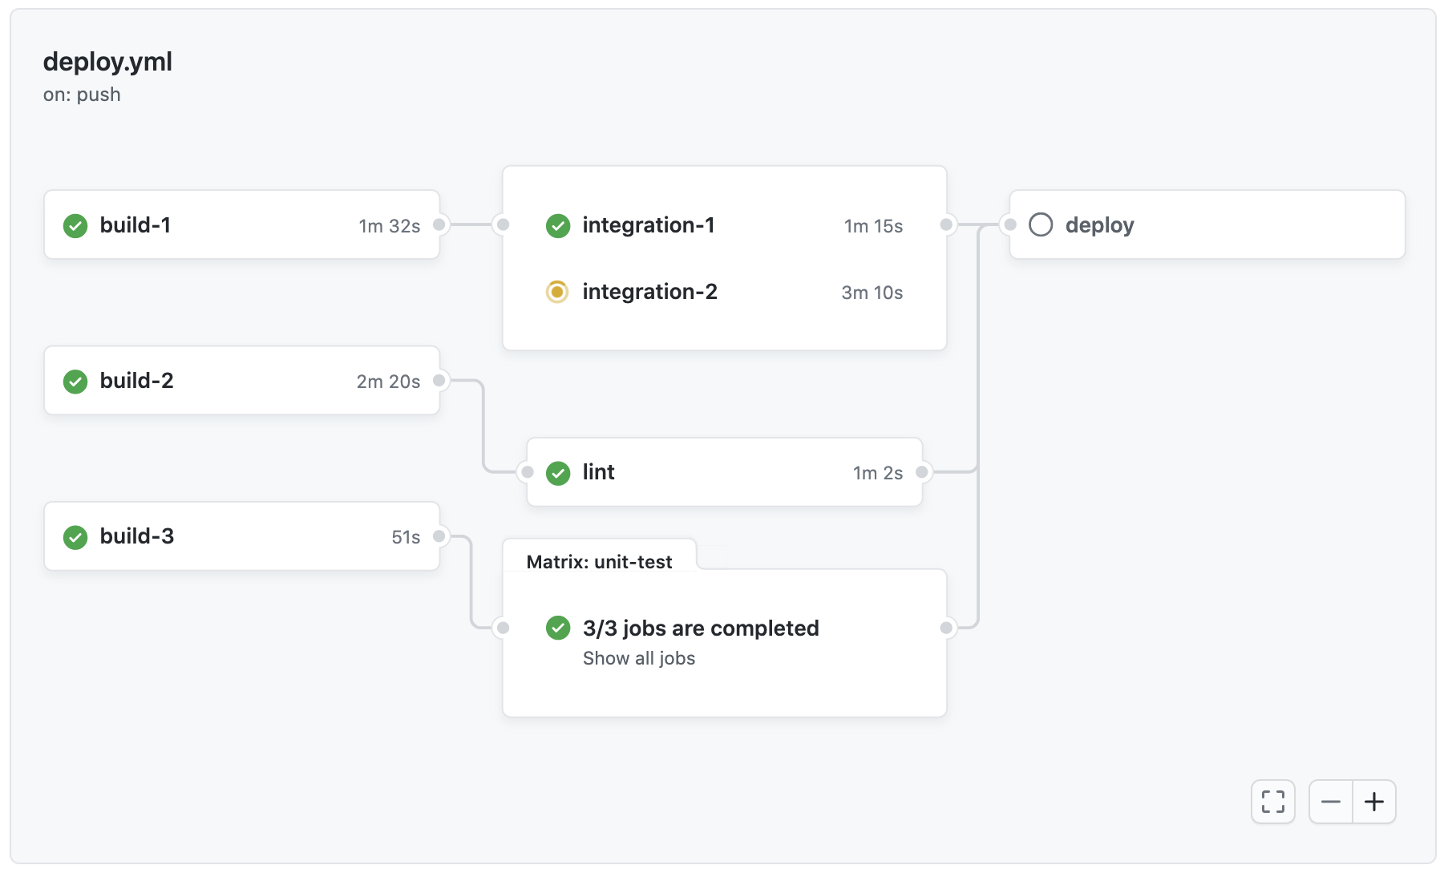
A quick tour of GitHub
04 · GIT & GITHUB
github.com · Actions
README.md
The front page, in Markdown
Commits
Your history, with names and messages
Issues
Bugs, tasks and questions
Pull requests
Propose and review changes
Actions
Build and test on every push
.gitignore
Files Git must never track
Object Oriented Programming · Seminar 1 · 71

Slide 72
Six Git habits for this course
04 · GIT & GITHUB
01
02
03
Commit every seminar
Explain the change
Pull first, push last
Small, focused commits, at least one per session.
“Add academicStanding()”, not “stuff”.
Start with pull; end with push.
04
05
06
No secrets
Ignore build output
History is your portfolio
Never commit passwords or keys.
bin/ stays out, always.
By week 14 it shows how you built it.
Object Oriented Programming · Seminar 1 · 72

Slide 73
Read the message. Find it. Then ask.
ERROR
WHEN THINGS BREAK
Each course setup page has a troubleshooting section with the exact errors you're likely to see.

Slide 74
Java
TROUBLESHOOTING
You see | Fix
'java' is not recognized… | Open a new terminal. Still failing? Re-run the MSI › Change › turn on Set JAVA_HOME and Add to PATH. Check with where.exe java.
The version is not 25 | An older Java is found first. where.exe java and where.exe javac; remove extra ones in Settings › Apps.
java works, javac doesn't | You installed a JRE, not a JDK. Install the package ending in .JDK.
winget: package not found | winget source update, then try again, or use the MSI.
Could not find or load main class | Run java Check (no .class) from the folder that holds Check.class.
Object Oriented Programming · Seminar 1 · 74

Slide 75
Eclipse
TROUBLESHOOTING
You see | Fix
No Java virtual machine was found | The problem isn't Eclipse: java -version in a fresh terminal. Fix Java first.
UnsupportedClassVersionError | Project › Properties: Java Build Path › Libraries and Java Compiler must both say 25.
One project misbehaves, others fine | Properties › Java Compiler › “Enable project specific settings” outranks the workspace.
Random errors, files reverting | Workspace is in a synced folder. Move it to C:\dev\workspace; File › Switch Workspace.
Eclipse is extremely slow | Antivirus scanning every file. Exclude the workspace and Eclipse folders.
Object Oriented Programming · Seminar 1 · 75

Slide 76
Git and GitHub
TROUBLESHOOTING
You see | Fix
Password authentication is not supported | Use Git Credential Manager: where.exe git must be under C:\Program Files\Git\. Then git config --global credential.helper manager.
src refspec main does not match any | Nothing committed yet. git status, then finish the first commit.
Updates were rejected | git pull --rebase origin main, then git push -u origin main.
You committed bin/ | git rm -r --cached bin, commit, push. Files stay on disk.
fatal: not a git repository | Wrong folder or no git init. Check with pwd.
Object Oriented Programming · Seminar 1 · 76

Slide 77
Mac users: the same steps, different details
TROUBLESHOOTING
Java | Download the .pkg from adoptium.net: aarch64 for Apple chips (M1–M4), x64 for Intel. Check with java -version in Terminal.
Folders | ~/dev/workspace instead of C:\dev\workspace.
Eclipse | Installer for AArch64 or x86_64. First launch: right-click › Open. Preferences are under Eclipse › Settings…
Shortcuts | Cmd instead of Ctrl, except Ctrl+Space. Run: Cmd+Shift+F11. Quick fix: Cmd+1.
Git | Type git --version and click Install (Command Line Tools).
Push | The password prompt wants a personal access token (GitHub › Settings › Developer settings), not your password.
Object Oriented Programming · Seminar 1 · 77

Slide 78
Check all five
BEFORE YOU LEAVE
java -version and javac -version
both report 25
Eclipse opens and runs Check
Console shows “running on 25”
Your repo java-oop-surname exists
on GitHub, with your name on it
The whole loop works
add a second println, commit, push, see it on GitHub
Two commits in the history
click the commits link to check
Object Oriented Programming · Seminar 1 · 78

Slide 79
Questions?
Object Oriented Programming · Seminar 1 · 79

